Slide 1
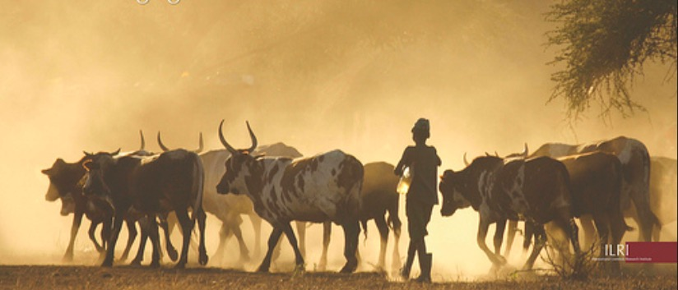
Climate Change and Livestock: Impacts, Adaptation, and Mitigation
Dr. Idat Galih Permana
Bogor Agricultural University
email: permana@apps.ipb.ac.id

Slide 2
Word Population
Human population is expected to increase from 7.2 to 9.6 billion by 2050 (UN, 2013).
The demand for food is expected to increase by 70%, and for livestock products 100% by 2050.
Meanwhile, total global cultivated land area has not changed since 1991

Slide 3
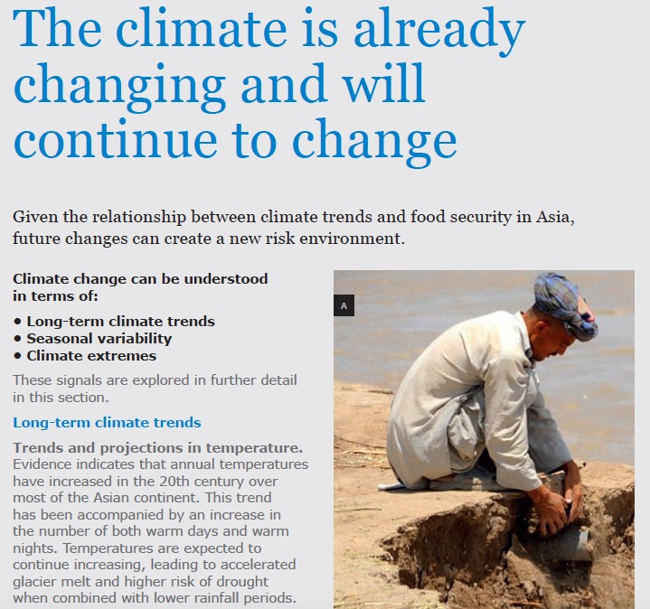
Is the climate already changing ?
Global climate change is primarily caused by greenhouse gas (GHG) emissions that result in warming of the atmosphere (IPCC, 2013).

Slide 4
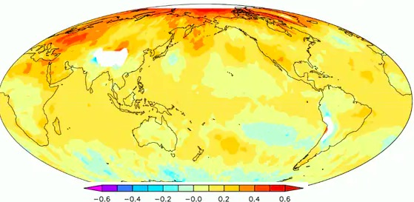
The IPCC 5th Assessment Report identiﬁed the range of increase in global average surface temperature by 2100, which is between 0.3 °C and 4.8°C (IPCC, 2013).

Slide 5
The temperature projection in Asia

Slide 6
What are the impact of Climate Change on Livestock ?
These impacts are primarily due to an increase in temperature and carbon dioxide (CO₂) concentration in the atmosphere, precipitation variation, and combination of these factors
Impacts of climate change on livestock are:
Production and quality of feed crop and forage
Water availability
Diseases
Animal growth and milk production
Reproduction
Biodiversity

Slide 7
Impact of CC - Quantity and Quality of Feeds
Reduce feed quantity and quality:
Plant growth change and less grain yield by increase of CO₂ concentration
Quality of feed crops and forage may be affected by increased temperatures and dry conditions
Composition of pastures by changes in temperature and CO₂ levels

Slide 8
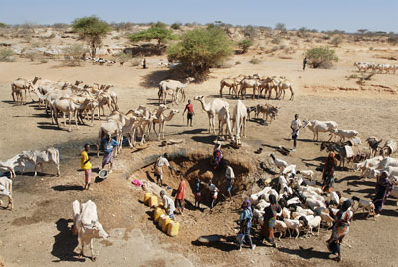
Impact of CC - Water Availability
Water availability issues will influence the livestock sector, which uses water for
animal drinking,
feed crops production,
and product processes
To address this issue, there is a need to produce crops and raise animals in livestock systems that demand less water or in locations with water abundances

Slide 9
Impact of CC - Animal Diseases
Animal health can be affected directly or indirectly by climate change, especially rising temperatures
The direct effects are related to the increase of temperature, which increases the potential for morbidity and death.
The indirect effects are related to the impacts of climate change on accelerate the growth of pathogens and/or parasites

Slide 10
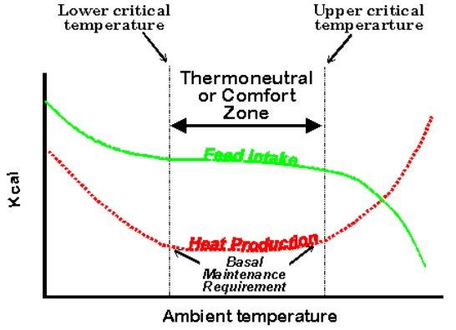
Impact of CC - Heat Stress
All animals have a thermal comfort zone, which is a range of ambient environmental temperatures that are beneficial to physiological functions

Slide 11
Impact of CC on Heat Stress
Heat stress on livestock is dependent on temperature, humidity, species, genetic potential, life stage, and nutritional status.
Impact of heat stress on livestock:
feed nutrient utilization,
feed intake,
animal production,
reproduction,
animal health,
mortality

Slide 12
Impact of Heat Stress
Feed nutrient utilization:
Livestock have some nutrient requirements including energy, protein, minerals, and vitamins, which are dependent on the region and type of animal
Failure to meet the dietary needs of animal during heat stress affects metabolic and digestive functions
Feed intake reduction leads to a negative energy balance and reduced weight gain
Reduction of water intake may also decrease sweating and feed intake

Slide 13
Effect of temperature on feed intake and digestibility

Slide 14
Impact of Heat Stress
Animal Production:
Heat stress is major problem on dairy cattle especially on high milk producing cows
High milk producing dairy cows generate more metabolic heat than low producing dairy cows. Therefore, high producing dairy cows are more sensitive to heat stress.
Heat stress on poultry:
Will reduce body weight gain, feed intake and carcass weight, and protein and muscle calorie content.
Heat stress on hens will reduce reproduction efficiency and consequently egg production because of reduced feed intake and interruption of ovulation

Slide 15
Impact of Heat Stress
Reproduction:
Reproduction efficiency of livestock may be affected by heat stress.
In cows and pigs, it affects oocyte growth, impairment of embryo development, and pregnancy rate
Cow fertility may be compromised by increased energy deficits and heat stress. Heat stress has also been associated with lower sperm concentration and quality in bulls, pigs, and poultry

Slide 16
Impact of Heat Stress
Animal Health:
Prolonged high temperature may affect metabolic rate, endocrine status, oxidative status, glucose, protein and lipid metabolism, liver functionality (reduced cholesterol and albumin), non-esterified fatty acids (NEFA), saliva production, and salivary HCO₃ - content.

Slide 17
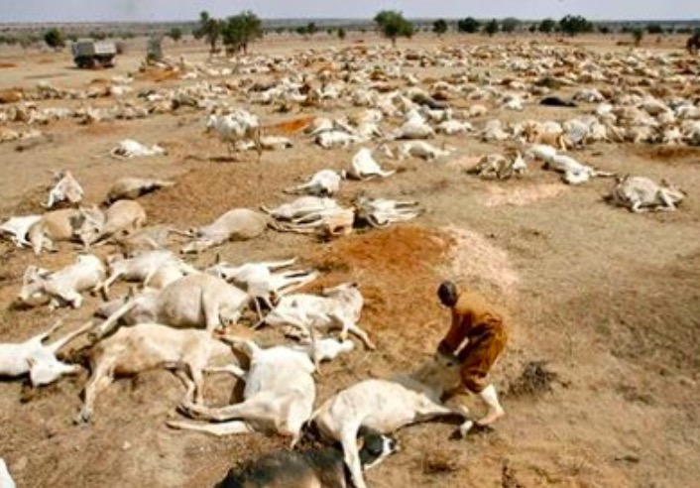
Impact of Heat Stress
Mortality:
Warm and humid conditions that cause heat stress can affect livestock mortality.
The increases in temperature between 1-5ºC might induce high mortality in grazing cattle.
As a mitigation measure, they recommend sprinklers, shade, or similar management practices to cool the animals.

Slide 18
Impact of CC on Biodiversity
Biodiversity refers to a variety of genes, organisms, and ecosystems found within a specific environment
Populations that are decreasing in genetic biodiversity are at risk, and one of the direct drivers of this biodiversity loss is climate change
Climate change may eliminate 15% to 37% of all species in the world. Temperature increases have affected species reproduction, migration, mortality, and distribution.

Slide 20
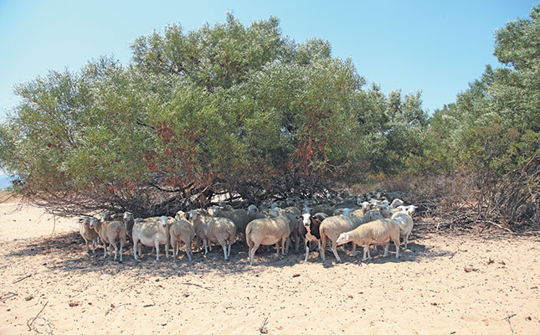
Impact of Livestock on Climate Change

Slide 21
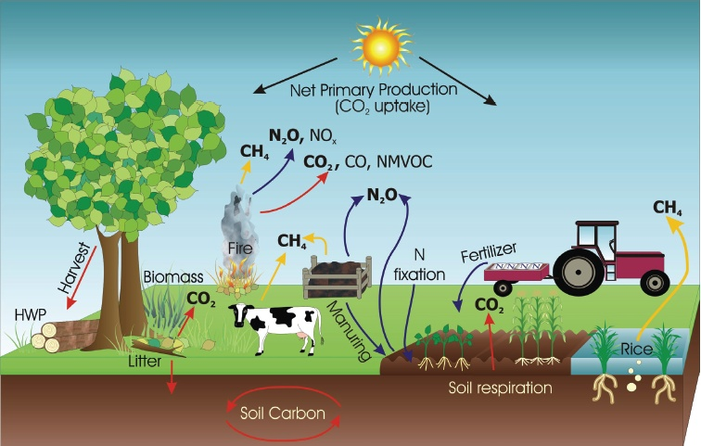
GHG Emission from Agricultural Sector
Source: IPCC (2006)

Slide 22
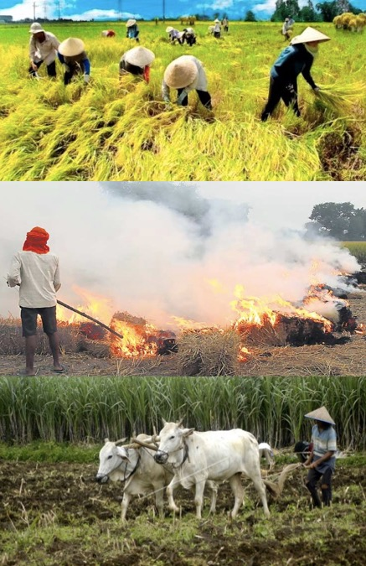
GHG Emission from Agricultural Sector
Rice Cultivation (CH₄)
Cropland Burning (CO₂, CH₄ , N₂O, NO_{x})
Liming (CO₂)
Urea Fertilizer (CO₂)
N₂O Emission from Managed Soil (N₂O)
Direct N₂O Soil
Indirect N₂O Soil
Livestock
Enteric Fermentation (CH₄ )
Manure Management (CH₄ and N₂O)

Slide 23
Type of livestock produce GHGs
Ruminant: beef cattle, dairy cattle, buffalo, sheep, goat
Non Ruminant (Pseudo-Ruminant): horse
Poultry: broiler, layer, local chicken, duck, goose, quail
Other Monogastric: swine

Slide 24
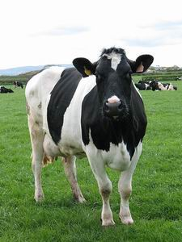
Emission from livestock
CH₄
Enteric Fermentation
Methane (CH₄)
Manure Management
Methane (CH₄)
Nitrous Oxide (N₂O)

Slide 25
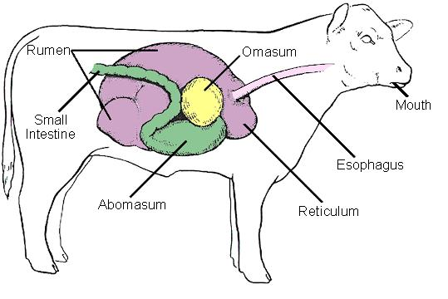
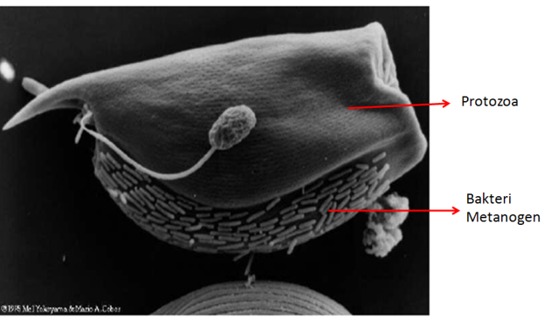
Enteric Fermentation Process
Ruminants (beef, dairy, buffalo, sheep, goat), horses, pigs produce methane (CH₄).
The gases produced by ruminant livestock are CO₂, CH₄, H₂S, H₂O
Methane is produced from the methanogenesis process in the rumen with the help of methanogen bacteria.
CO₂ + 4H₂ ==> CH₄ + 2H₂O

Slide 26
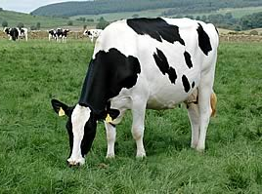
Emission Factor (EF) in livestock depends on:
Type and Breed of Livestock
Weight and Age
Milk Production
Reproduction Status
Quality of feed
Feeding system
Manure Management System

Slide 27
CH₄ emission factors for enteric fermentation
No | Species Type | Enteric Fermentation (kg/head/year)
1 | Beef Cattle | 47
2 | Dairy Cattle | 68
3 | Bufallo | 55
4 | Sheep | 5
5 | Goat | 5
6 | Pig | 1
7 | Horse | 18
8 | Local Chicken | -
9 | Broiler | -
10 | Layer | -
11 | Duck | -
IPCC (2006) Table 10.10 & Table 10.11

Slide 28
Impact of livestock on climate change
GHG emissions
Land uses
Feed production
Animal production
Manure
Processing and transport

Slide 29
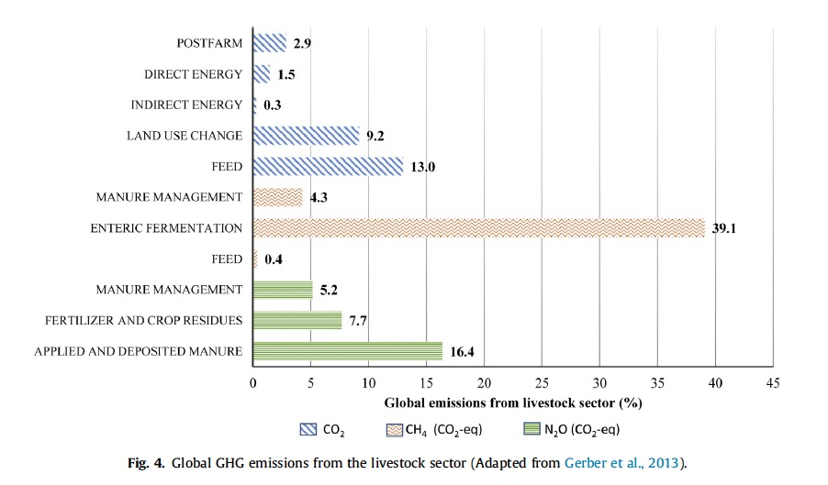
Global GHG emissions from the livestock sector

Slide 30
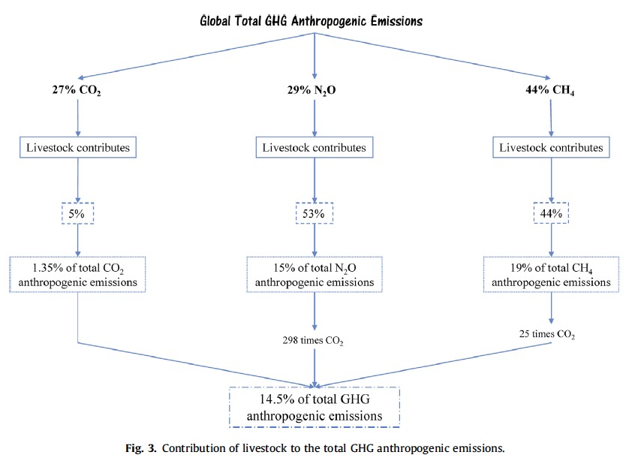
Contribution of livestock to the total GHG anthropogenic emissions

Slide 31
GHC from livestock
GHG contributor from livestock:
Beef cattle 41%
Dairy 20%
Swine 9%
Buffalo 8%
Poultry 8%
Small ruminant 6%

Slide 32
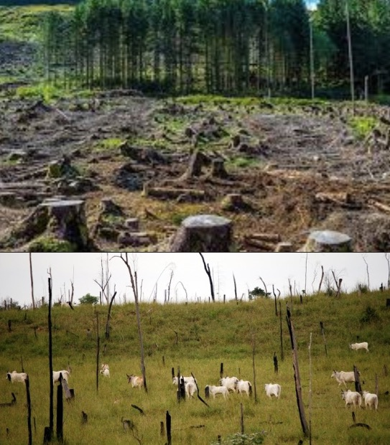
Impact of Livestock - Land Use
The increasing demand for livestock products has significantly changed the natural landscape.
Land degradation is the deterioration of physical, chemical, and biological properties of soil.
Land use change affects the natural carbon cycle (releases carbon into the atmosphere) increasing GHG emissions.

Slide 33
Impact of Livestock - Feed Production
The use of manure and synthetic fertilizers for forage and feed crop production are contributor of GHG emissions related to the livestock sector
These make up 45% of global livestock anthropogenic GHG emissions, consisting primarily as CO₂, N₂O and NH₄
The livestock sector contributes significantly to GHG emissions through the production of nitrogenous fertilizers used to produce crops for animal feed
N²O is another contributor to GHG emissions. Fertilizer use, agricultural nitrogen fixation, and atmospheric nitrogen deposition generally increase N₂O emissions

Slide 34
Impact of Livestock - Animal Production
Livestock contributes 44% of the world’s anthropogenic CH₄ emissions through their normal digestive processes (enteric fermentation) and manure management
Feed composition and feed intake can vary enteric fermentation and hence methane emissions.
Increasing the concentrate (high energy feeds containing cereal grains and oil meals) proportion in the animal diet can reduce methane emissions from the animal

Slide 35
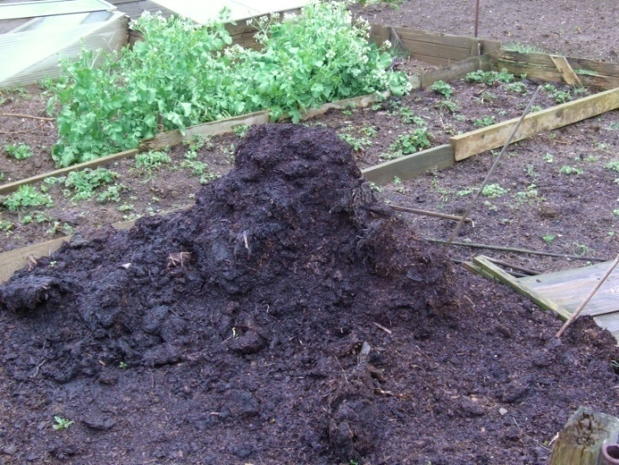
Impact of Livestock - Manure Management
Methane:
produced from manure management processes in all types of livestock (dairy cattle, beef cattle, buffalo, sheep, goats, pigs, ducks, chicken, chicken, chicken) anaerobically
Liquid handling (anaerobic condition) is more likely to occur methanogenesis than a solid handling.
CH₄

Slide 36
Manure Management
Direct N₂O
Generated from the combined process of nitrification and N denitrification of the manure during storage.
The nitrification process is a change of N-ammonia to N-nitrate in sufficient oxygen condition.
Indirect N₂O
Generated from N-volatile such as NH₃ or NO_{x}. An easy to volatile organic N is urea and ureic acid
N₂O
N₂O

Slide 37
Impact of Livestock – Manure Management
Manure methane emissions are a function of air temperature, moisture, pH, storage time, and animal diet
Estimated global methane emissions from manure decomposition of 17.5 million tonnes of CH₄ per year.
N₂O emissions from manure storage are dependent on environmental conditions, handling systems, and duration of waste management

Slide 38
Impact of Livestock - Processing and Transport
Energy use depends on the type of livestock system
More than half of the energy used in confinement systems is for feed production
including seed, herbicides, pesticides, and machinery. Substantial energy is also used for heating, cooling, and ventilation systems
Transportation of livestock products to retailers and transport of feed to livestock farms contribute to GHG emissions.

Slide 39
Adaptation Measures

Slide 40
Adaptation to climate change ?
Climate change adaptation is a response to global warming and climate change, that seeks to reduce the vulnerability of social and biological systems to relatively sudden change and thus offset the effects of global warming.

Slide 41
Adaptation Measures
Adaptation strategies can improve the resilience of crop and livestock productivity to climate change
Adaptation measures:
production and management system modifications
breeding strategies,
institutional and policy changes,
science and technology advances, and
changing farmers’ perception and adaptive capacity

Slide 42
Livestock production and management systems
An adaptation such as the modification of production and management systems:
Diversification of livestock and crop varieties
Agroforestry (establishing trees alongside crops and pastures in a mix) as a land management
Changes in mixed crop-livestock systems
Improving feeding practices:
modification of diets composition, changing feeding time and/or frequency
Shifting locations of livestock and crop production

Slide 43
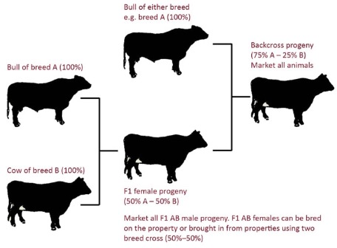
Breeding strategies
Changes in breeding strategies can help animals increase their tolerance to heat stress and diseases and improve their reproduction and growth development
Cross between local breed and exotic breed is more adaptive to the warm temperature

Slide 44
Farmers’ perception and adaptive capacity
By understanding farmers’ perceptions and including them in rural policy development, there is a greater chance of accomplishing food security and environmental conservation objectives

Slide 45
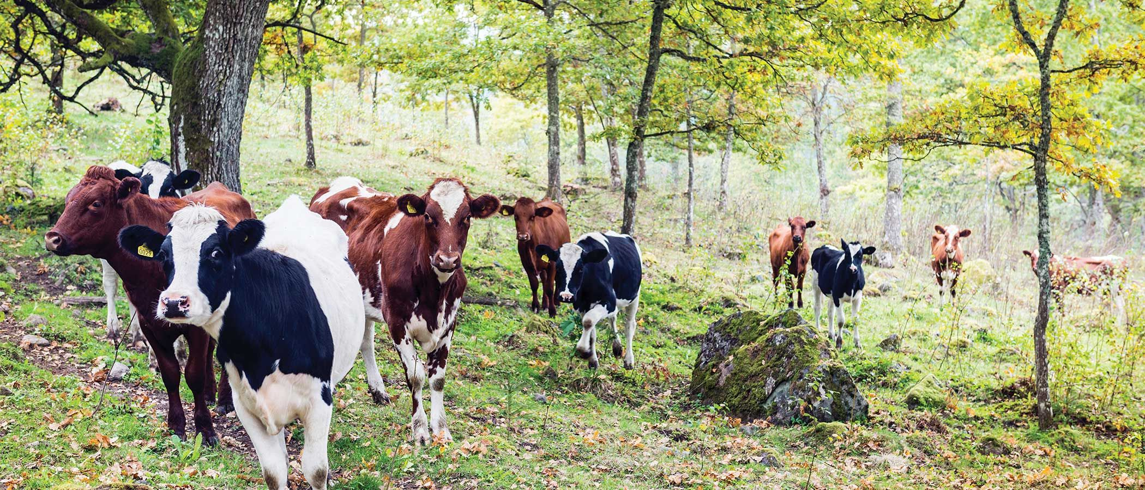
Mitigation Measures

Slide 46
Mitigation Measures
There is potential to reduce livestock sector GHG emissions through the implementation of different technologies and practices.
Carbon sequestration.
Enteric fermentation
Manure management
Fertilizer management
Shifting human dietary trends

Slide 47
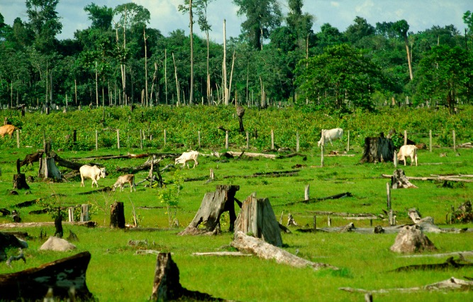
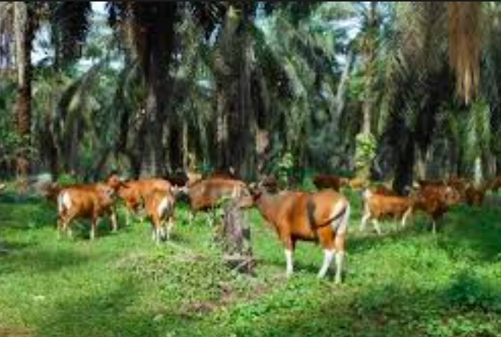
Mitigation Measures on Carbon Sequestration
Carbon sequestration can be achieved through:
decreasing deforestation rates,
reversing of deforestation by replanting,
targeting for higher-yielding crops with better climate change adapted varieties,
and improvement of land and water management

Slide 48
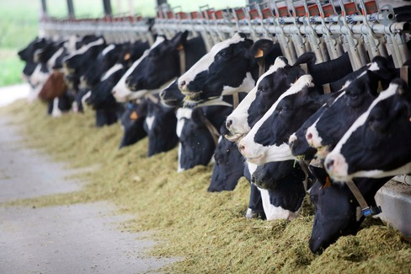
Mitigation Measures on Enteric Fermentation
Enteric fermentation:
Enteric fermentation is a source of methane emissions that can be reduced through practices such as improvement of animal nutrition and genetics
Mitigation practices:
increasing dietary fat content
providing higher quality forage
increasing protein content
providing supplements (e.g. bovine somatotropin, probiotics, etc.)
the use of anti methanogens (tannin, saponin, etc.)

Slide 49
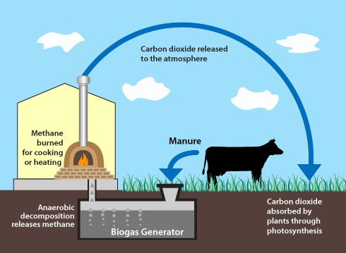
Mitigation Measures on Manure Management
Manure management:
Most methane emissions from manure management are related to storage and anaerobic treatment.
Mitigation practices:
shortening storage duration,
improving timing and application of manure,
used of anaerobic digesters (biogas),
covering the storage,
using a solids separator, and
changing the animal diets

Slide 50
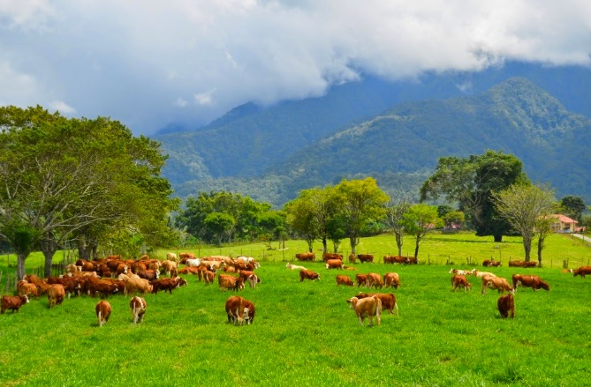
Mitigation Measures on Fertilizer Management
Fertilizer management:
Fertilizer application on animal feed crops increases nitrous oxide emissions
Mitigation practices:
increasing nitrogen use efficiency by plant breeding and genetic modifications
using organic fertilizers
regular soil testing
using technologically advanced fertilizers,
combining legumes with grasses in pasture areas

Slide 51
Mitigation Measures on Shifting Human Dietary Trends
Shifting human dietary trends:
reduction in meat consumption may significantly reduce GHG emissions (??). Because beef accounts for a large portion of GHG emissions from the livestock sector and it is the least resource-efficient animal protein producer
This program may be only relevant for develop countries, but not in developing countries (meat consumption in South East Asia is relatively low)

Slide 52
CONCLUSIONS
Climate change will affect livestock production and consequently food security
Livestock production will be negatively impacted (due to diseases, water availability, etc.)
Conversely, livestock production also influences climate change.
Climate change adaptation, mitigation practices, and policy frameworks are critical to protect livestock production

Slide 53
References:
Melissa Rojas-Downing M., A. Pouyan Nejadhashemi, Timothy Harrigan, Sean A. Woznicki. 2017. Climate change and livestock: Impacts, adaptation, and Mitigation. Climate Risk Management 16 (2017) 145–163
Thornton, P.K.,, J. van de Steeg, A. Notenbaert, M. Herrero. 2009. The impacts of climate change on livestock and livestock systems in developing countries: A review of what we know and what we need to know. Agricultural Systems 101 (2009) 113–127

Slide 54
Thank you

